Slide 1
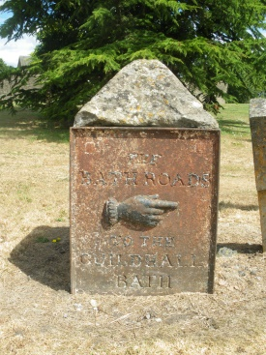
The Importance of Waymarkers
In your group discuss the following questions
Why do you think waymarkers are important?
What do you think waymarkers looked like in the days of horses and highwaymen?
What would they have been made of?
What do modern day waymarkers look like?

Slide 2
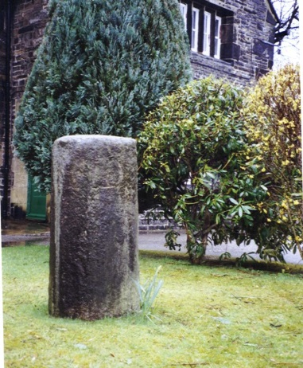
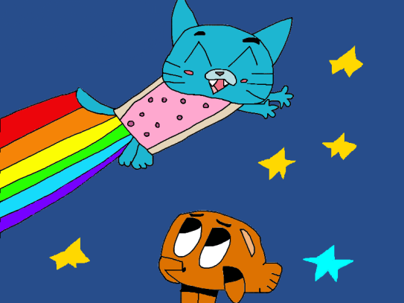
What are Milestones?
Using the internet, find the Milestone Society website http://www.milestonesociety.co.uk/
You can find out about the history of milestones dating as far back as the Roman times
It’s amazing that 117 Roman milestones are still around the countryside to this day!

Slide 3
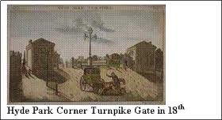
History – facts about toll gates
In the 17th century, it took 16 days to travel the 400 miles from London to Edinburgh. So Turnpike Trusts were set up, by Acts of Parliament, from 1706 to the 1840s. People were charged to travel on the roads and the money was used to maintain them. The name ‘turnpike’ comes from the spiked barrier at the Toll Gate. From 1767, mileposts were compulsory on all turnpikes, not only to inform travellers of direction and distances, but to help coaches keep to schedule and for charging for changes of horses at the coaching inns. At the height of the turnpike era, there were 20,000 miles of roads with milestones!!

Slide 4
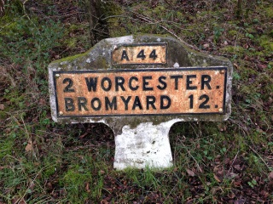
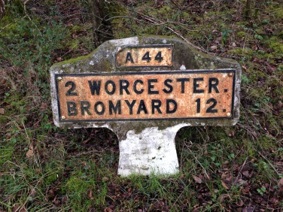
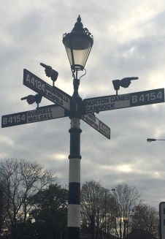
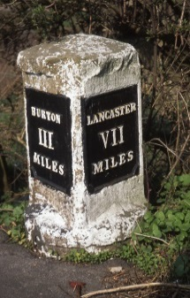
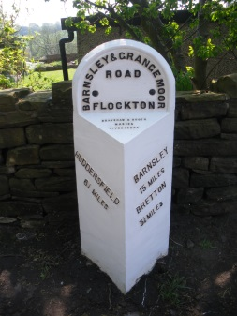
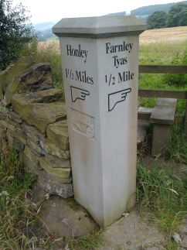
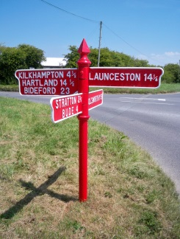
Find different types of waymaker
Look on the Milestone Society website or on Geograph.
There are many different types of waymarker - milestones, guide posts, fingerposts.
Choose 4 or 5 of your favourite waymarkers and explain to the group why you chose them.
Was it the colour, shape, the wording?

Slide 5
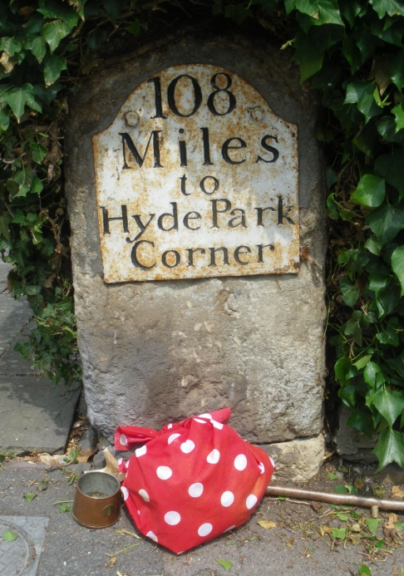
Every picture tells a story
Look at this milestone – what do you think the story of this milestone is?
Why might there be a knotted handkerchief on a stick?

Slide 6
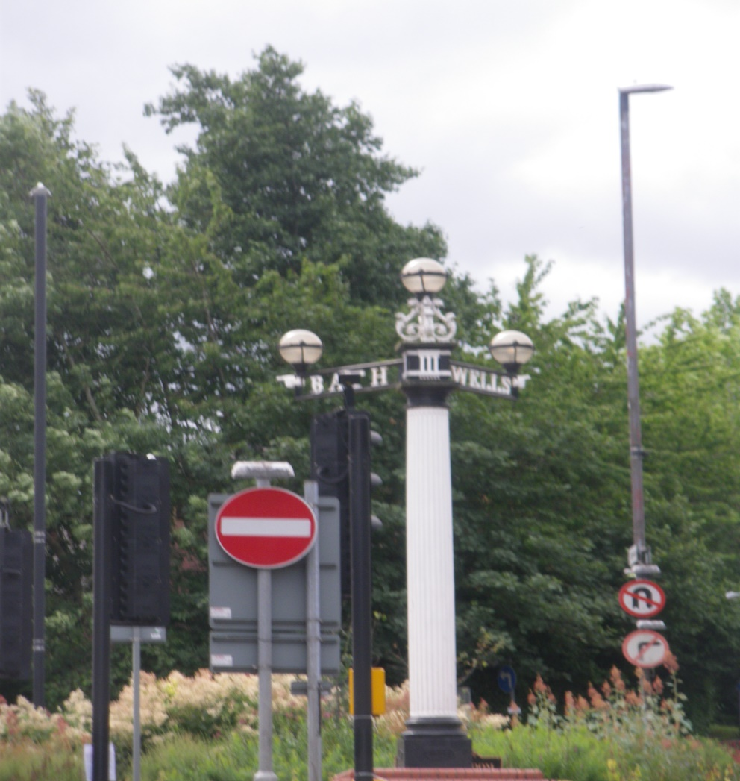
Waymarkers
How many waymarkers and signs can you see in this picture?

Slide 7
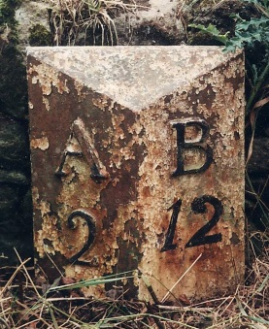
Waymarker Story
Use the information from this PPT and the Milestone
Society website to make your own Powerpoint about waymarkers. Are there any left in your area? What happened to the milestones in World War ll ?
or
Choose your favourite waymarker and tell a story about it.
You can make up your own story.
Here are some ideas to get you started :
Think about the history of it, where you saw it, what it was like using toll roads in the 18th century?
You could write about life as a highwayman trying to escape the king’s men and using waymarkers to find somewhere safe to hide….

Slide 8
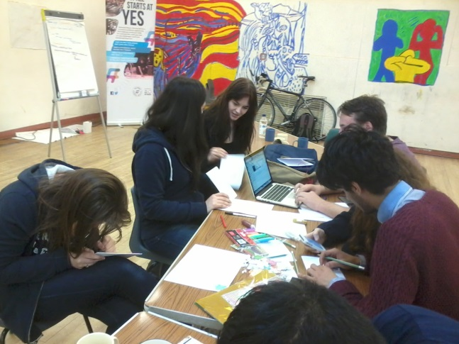
‘Milestones’ are events, too
Milestones are figurative/metaphorical as well as physical. We speak of a ‘milestone’ event – eg an 18th Birthday or a wedding anniversary, or passing an important exam.
Design a greetings card to celebrate a milestone event such as a wedding, the birth of a baby or a particular birthday –

